Slide 1
Toxic Comment Classification
Shendy Boenyamin

Slide 2
Introduction
This project will focus on using NLP to find out whether a comment is toxic or clean

Slide 3
Data
It consists of large number of Wikipedia comments which have been labeled by human raters for toxic behavior. The types of toxicity are:
toxic, severe toxic, obscene, threat, insult, identity hate
Data source: https://www.kaggle.com/c/jigsaw-toxic-comment-classification-challenge/data
Disclaimer: the dataset contains text that may be considered profane, vulgar, or offensive.

Slide 4
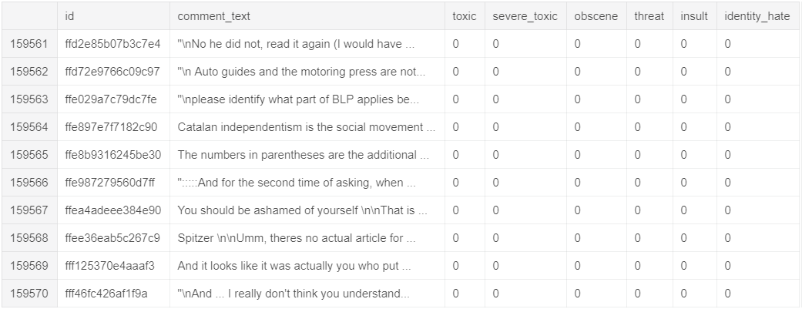
Data

Slide 5
Objective
To build a model that’s capable of detecting different types of of toxicity like threats, obscenity, insults, and identity-based comments from Wikipedia’s talk page edits.

Slide 6
Problem Statement
Everyday while surfing the social media, playing games, and watching streaming we encounter a lot of comments, reviews, tweets, in-game chat, etc. that we believe might hurt the sentiments of the people of a particular group or a community. These comments are believed to be toxic in nature, which thus defines the problem that we are trying to solve with this project.

Slide 7
Target
Game’s communities chats or any other platforms (e.g. twitch,youtube, instagram) that usually have toxic culture.
Why ?
Cause nowadays a lot of online communities that practicing this toxic culture that effect people in real life such as cyber bullying that have a bad impact to the victim.

Slide 8
Let’s move to the notebook

Slide 9
Conclusion
The model able to predict clean accurately.
Moderately able to guess all the label

Slide 10
Future Improvements
Add more data to the train set
Tuning model to increase recall and precision on the toxic label

Slide 11
Thank You

